Slide 1
11.2 Universal approximators

Slide 2
Perfect data

Slide 3
A *perfect* dataset for regression or two-class classification has two important (albeit, unrealistic) characteristics:
It is completely noiseless
It is infinitely large
When we have unfettered access to perfect data, perfect features can be *learned* automatically by combining elements from a set of basic feature transformations, known as *universal approximators*, the most popular of which include *fixed-shape approximators*, *neural networks*, and *trees*.

Slide 4
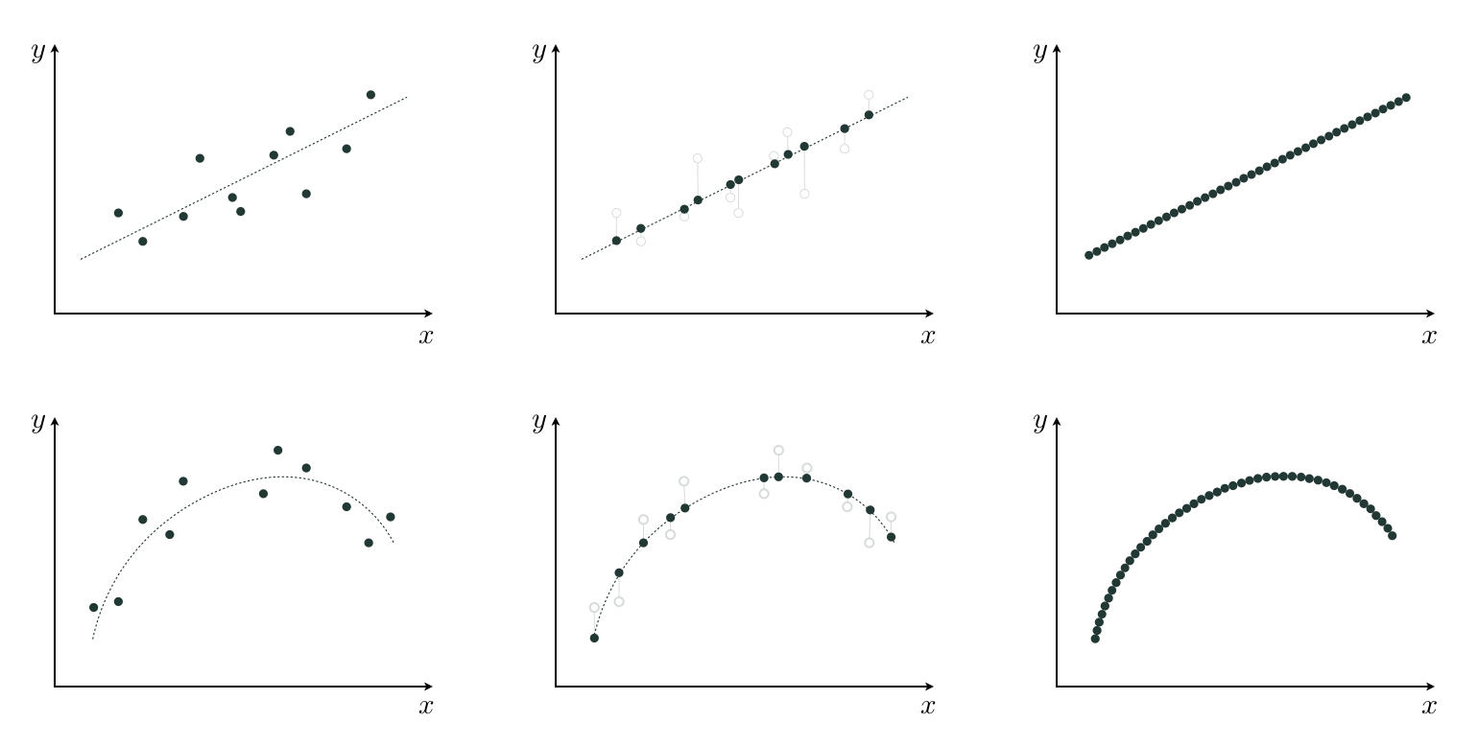
(top left) A realistic linear regression dataset. (top middle) The noiseless version. (top right) The perfect version of the same data. (bottom left) A realistic nonlinear regression dataset. (bottom middle) The noiseless version. (bottom right) The perfect version, that is noiseless and infinitely large.

Slide 5
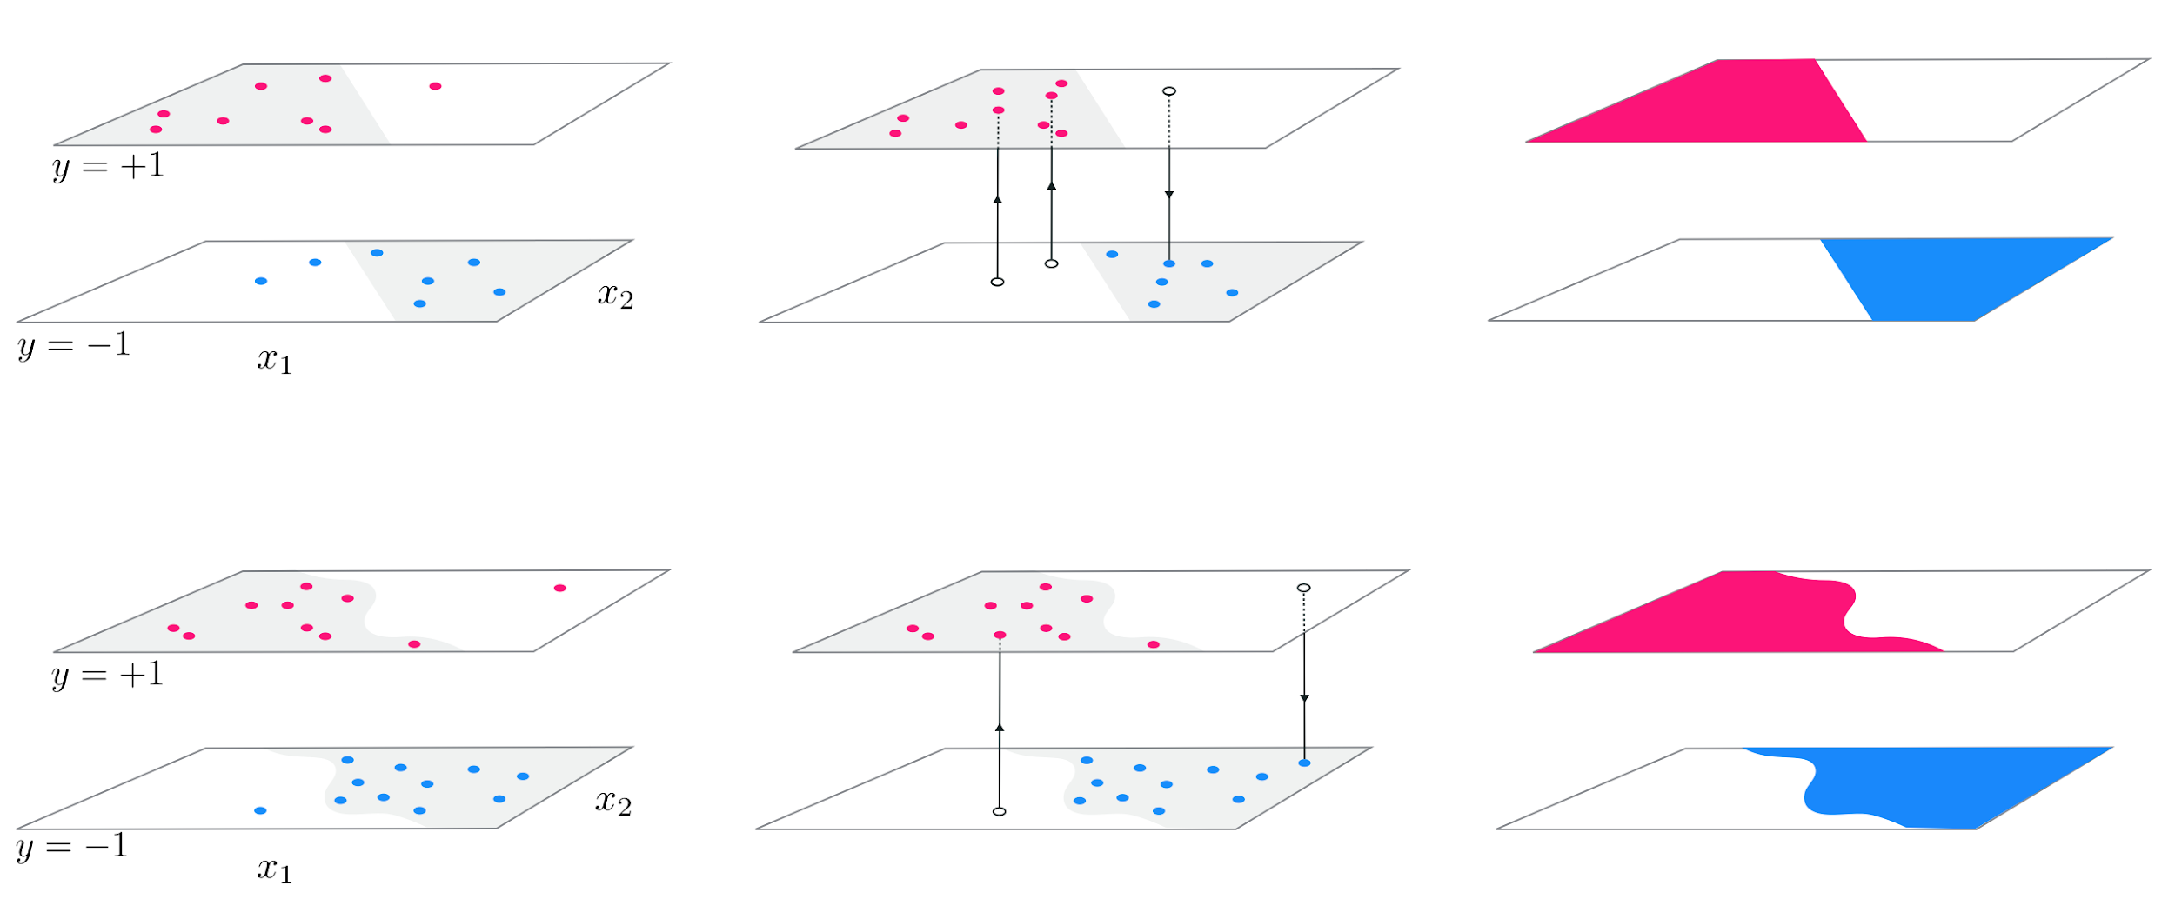
(top left) A realistic linear two-class classification dataset. (top middle) The noiseless version. (top right) The perfect version of the same data. (bottom left) A realistic nonlinear two-class classification dataset. (bottom middle) The noiseless version. (bottom right) The perfect version, that is noiseless and infinitely large.

Slide 6
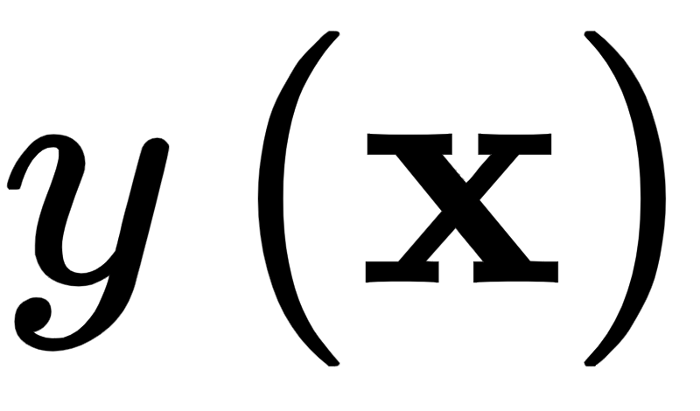
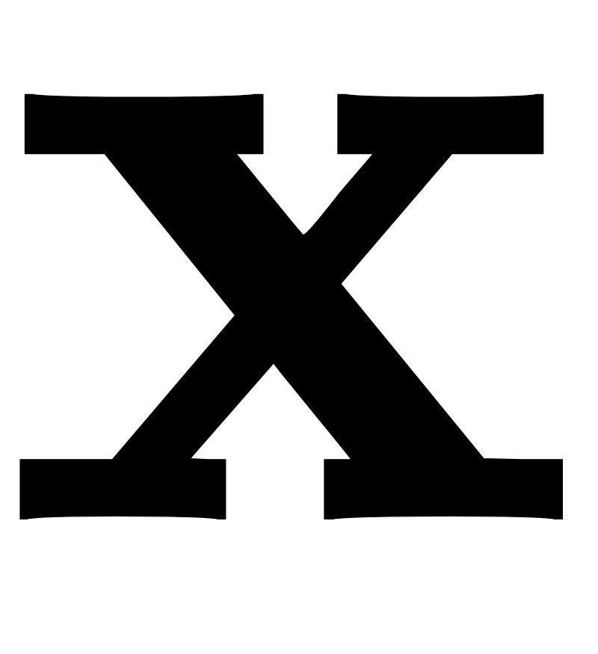
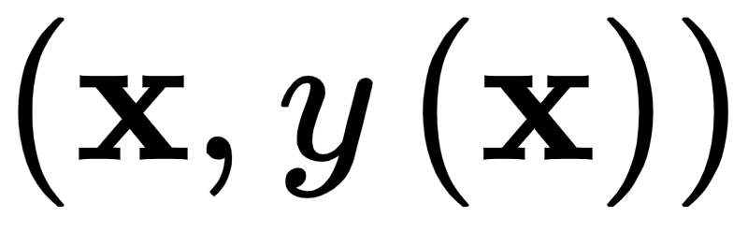
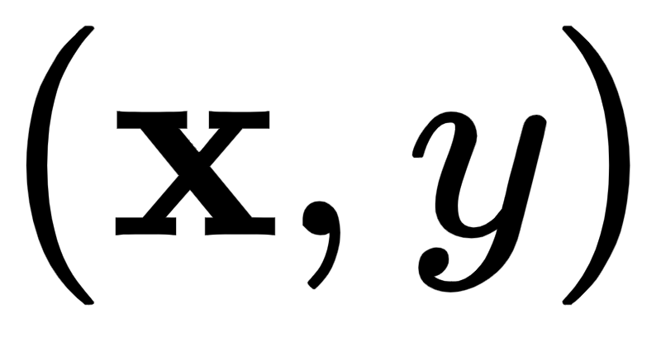
A perfect regression or two-class classification dataset is a continuous (or piece-wise continuous) function with unknown equation.
Because of this we will refer to our perfect data using the function notation , meaning that the data pair defined at input can be written as either or likewise
It is important to bear in mind that the function notation does not imply that we have knowledge of a closed form *formula* relating the input/output pairs of a perfect dataset, we do not!

Slide 7
The spanning set analogy for universal approximation

Slide 8
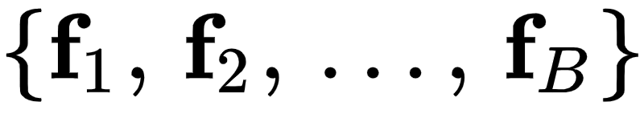
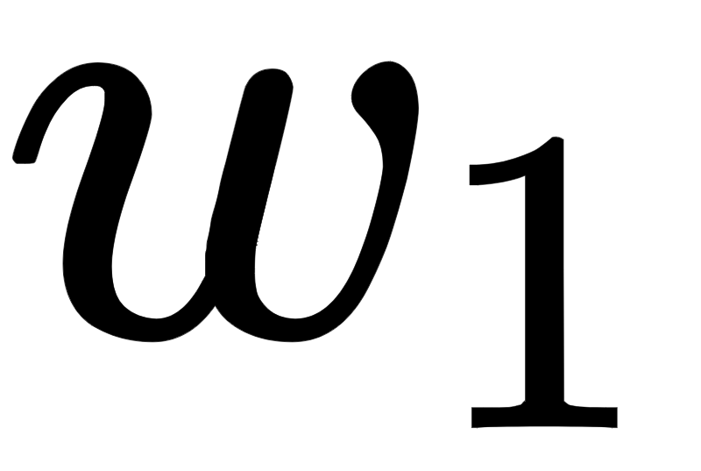
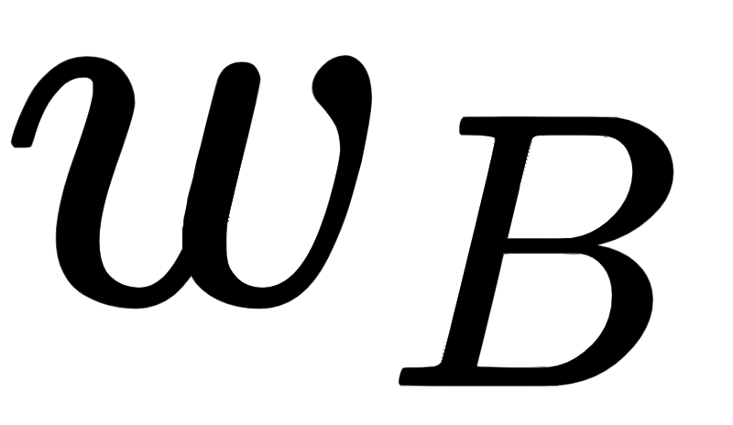
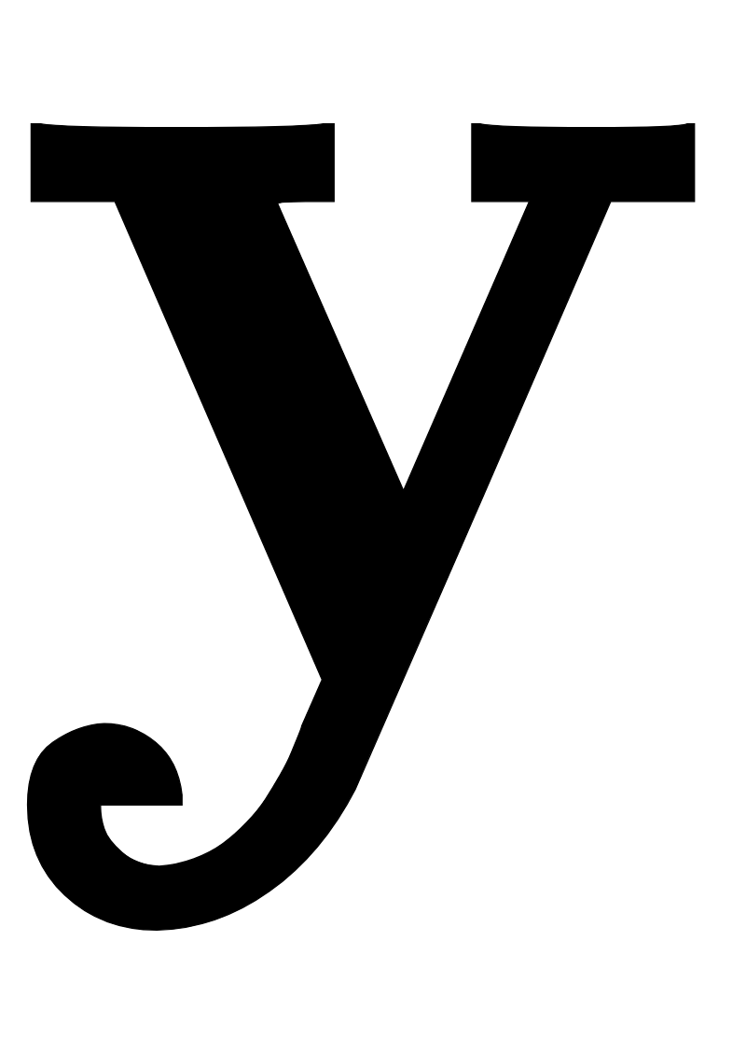
Linear combinations of vectors
Assume we have a set of B vectors , each having dimension N.
We call this a *spanning* set of vectors.
Given a particular set of weights through , the linear combination below defines a new N dimensional vector

Slide 9
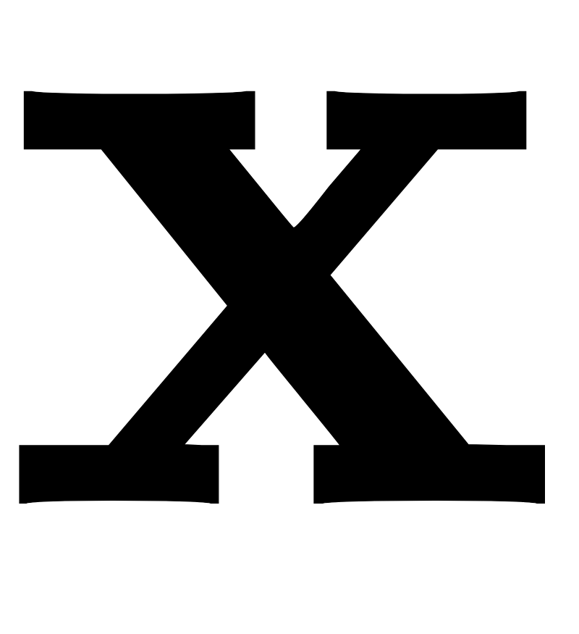
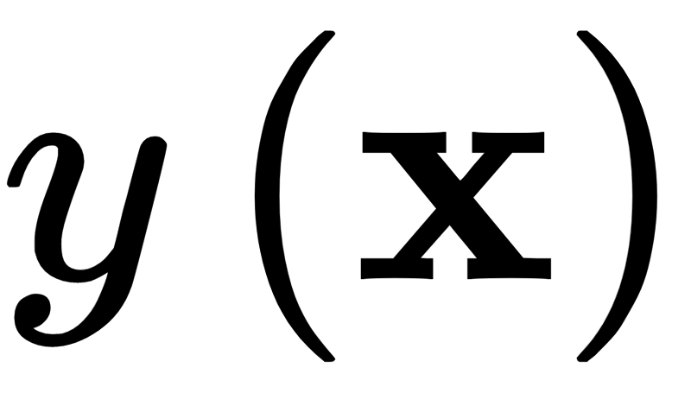
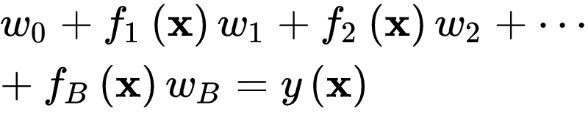
Linear combinations of functions
Similarly, given a spanning set of B nonlinear functions (where the input is ) is N dimensional and output is scalar) and a corresponding set of weights, the linear combination below defines a new function

Slide 10
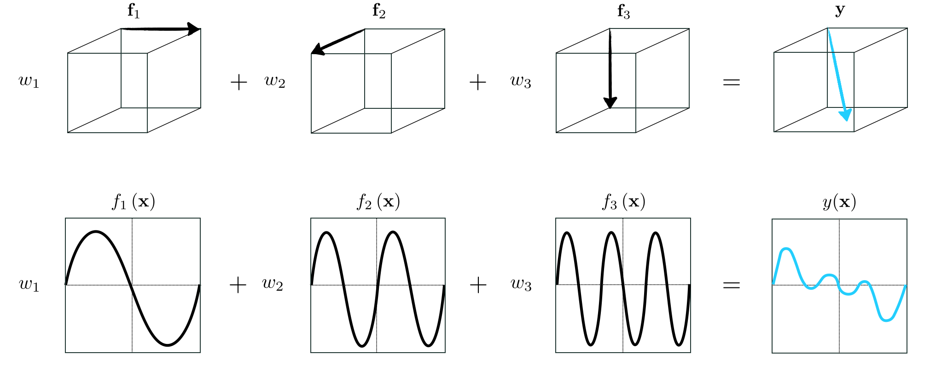
A particular linear combination of three vectors (top) and three functions (bottom)

Slide 11
Capacity of spanning sets

Slide 12
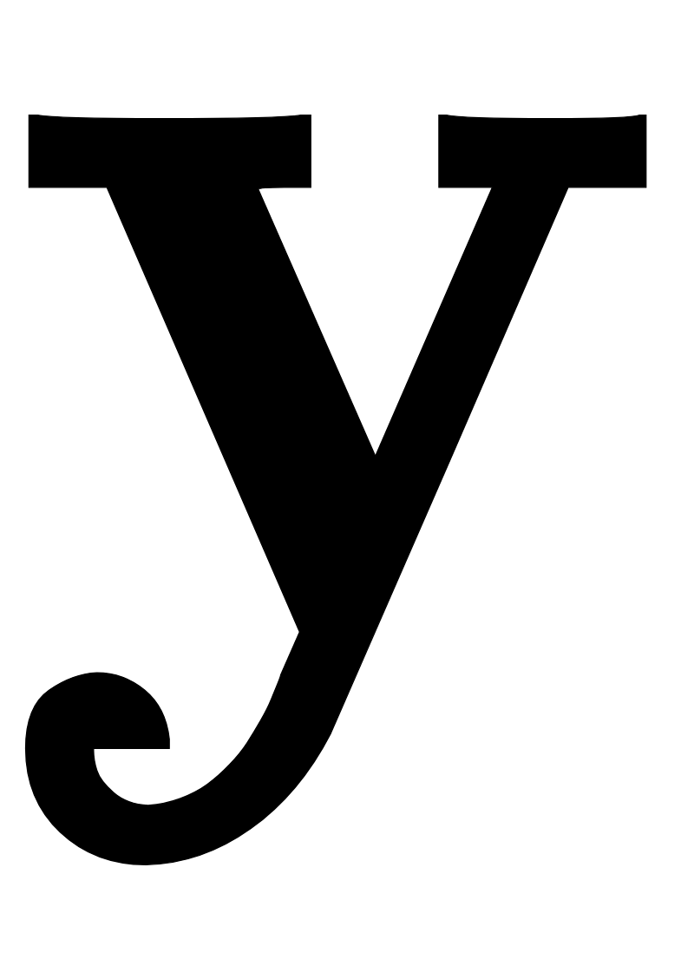
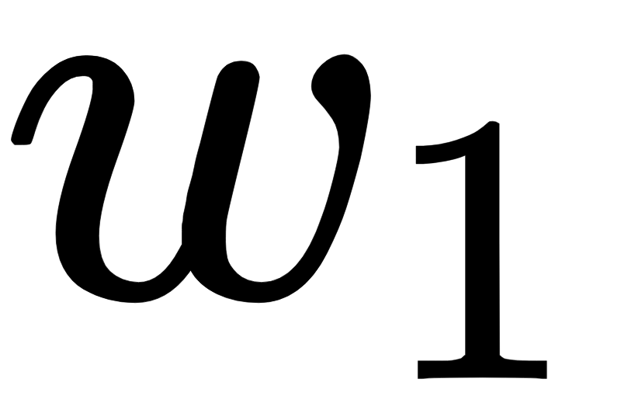
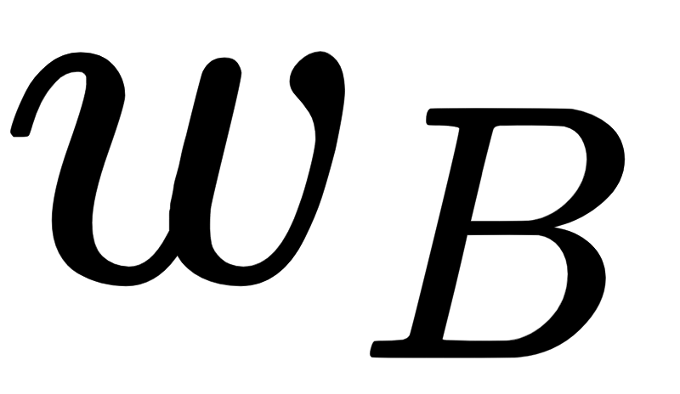
Vector approximation problem
Computing the vector in , for a *given* set of weights through , is a trivial affair.
The inverse problem, i.e., finding the weights given , is slightly more challenging.
Stated algebraically, we want to find the weights through such that the following holds as well as possible.

Slide 13
How well the *vector approximation* holds depends on three crucial and interrelated factors:
1. The diversity (i.e., linear independence) of the spanning vectors
2. The number B of them used (in general the larger we make B the better)
3. How well we tune the weights through via minimization of an appropriate cost

Slide 14
Factors (1) and (2) determine a spanning set's *rank* or *capacity*, that is a measure for the range of vectors we can possibly represent with such a spanning set.
A spanning set with a *low capacity*, that is one consisting of a non-diverse and/or a small number of spanning vectors can approximate only a tiny fraction of those present in the entire vector space.
A spanning set with a *high capacity* can represent a broader swath of the space.

Slide 15
Function approximation problem
We can try to find the weights through , for a given , such that the following holds as well as possible.

Slide 16
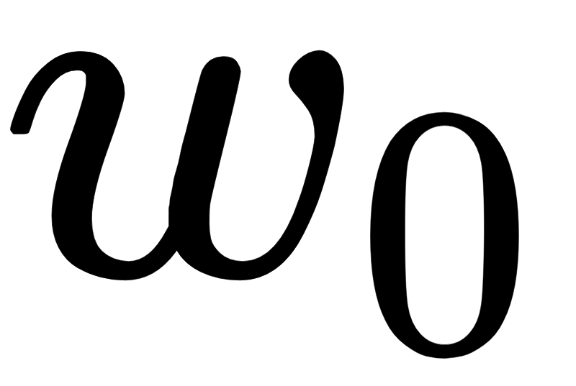
As with the vector case, how well this *function approximation* holds depends on three crucial and interrelated factors:
1. The diversity of the spanning functions
2. The number B of them functions used
3. How well we tune the weights through (as well as any parameters internal to our nonlinear functions) via minimization of an appropriate cost.

Slide 17
In analogy to the vector case, factors (1) and (2) determine the *capacity* of a spanning set of functions.
A *low capacity* spanning set that uses a non-diverse and/or small array of nonlinear functions is only capable of representing a small range of nonlinear functions.
A spanning set with a *high capacity* can represent a wider swath of functions.

Slide 18
Universal approximation

Slide 19
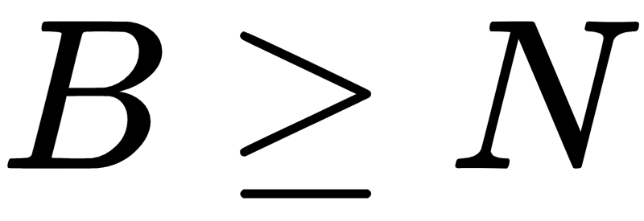
Consider the vector approximation problem
If and at least N of the vectors are linearly independent, then our spanning set has maximal capacity and we can therefore approximate *every* N dimensional vector to *any* given precision.
Such a set of spanning vectors can approximate (or in this case perfectly represent) every vector *universally*.

Slide 20
Now consider the function approximation problem
If we choose the right kind of spanning functions, then our spanning set has maximal capacity and we can therefore approximate *every* function to *any* given precision.
Such a set of spanning functions, of which there are infinitely many varieties, can approximate every function *universally*, and is thus often referred to as a *universal approximator*.

Slide 21
Note: one difference between the vector and the function regime of universal approximation is that with the latter we may need infinitely many spanning functions to be able to approximate a given function to an arbitrary precision (whereas with the former it is always sufficient to set B greater than or equal to N).

Slide 22
Popular universal approximators

Slide 23
In theory there are infinitely many universal approximators.
However for the purposes of organization, convention, as well as a variety of technical matters universal approximators used in machine learning are often lumped into three main categories referred to as *fixed-shape approximators*, *neural networks*, and *trees*.
Each of these popular families has its own unique practical strengths and weaknesses as a universal approximator, a wide range of technical details to explore, and conventions of usage, which we explore in Chapters 12-14.

Slide 24
Example: The fixed-shape family of universal approximators

Slide 25
The family of *fixed-shape* functions consists of groups of nonlinear functions with no internal parameters, giving each a "fixed" shape.
Polynomials are a popular sub-family:
A combination of the first D units from this sub-family is often referred to as a *degree D* polynomial.
Polynomials are *naturally ordered* by their degree.

Slide 26
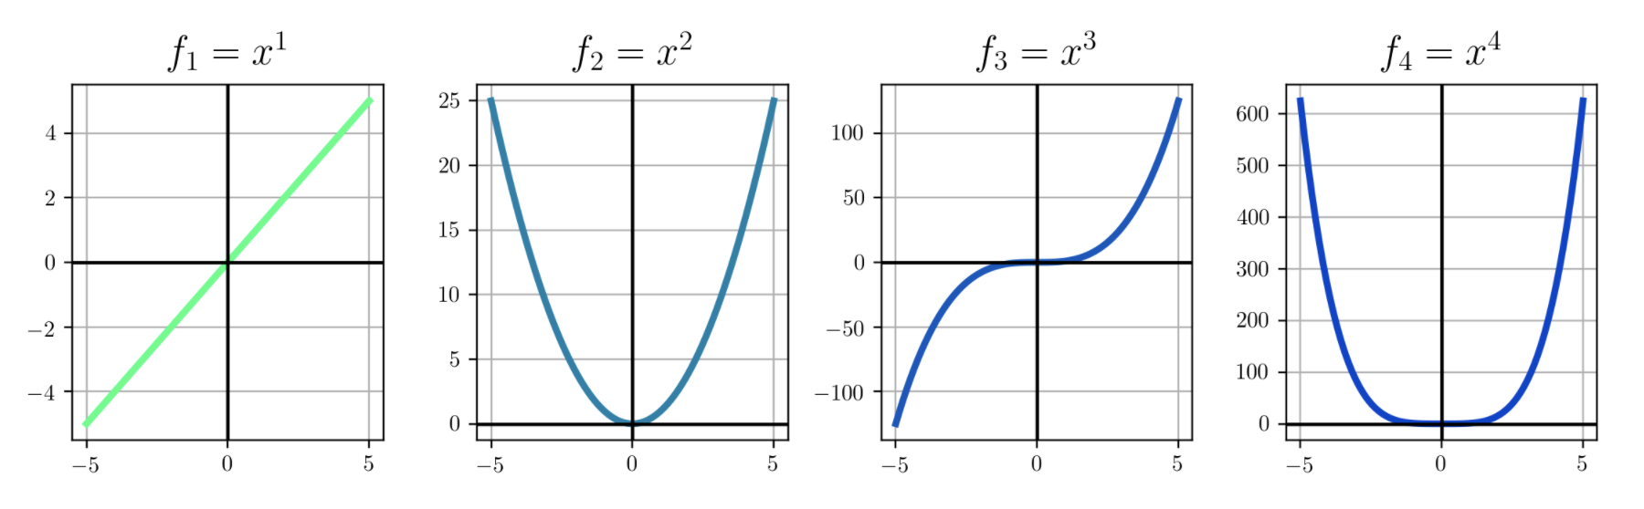

Slide 27
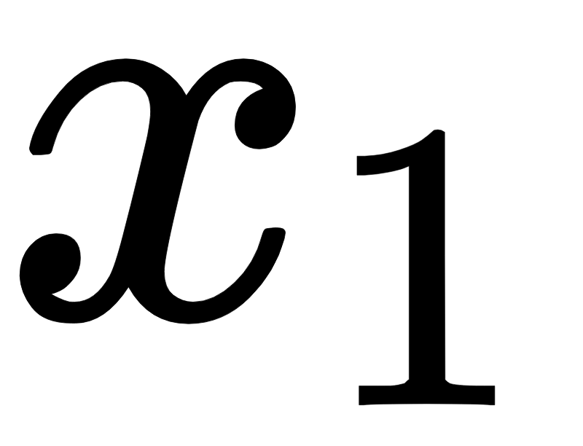
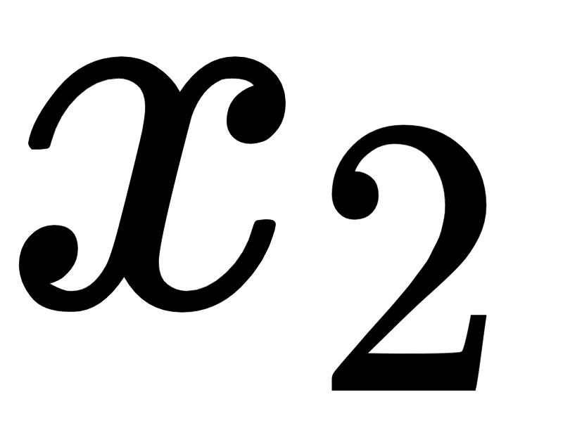
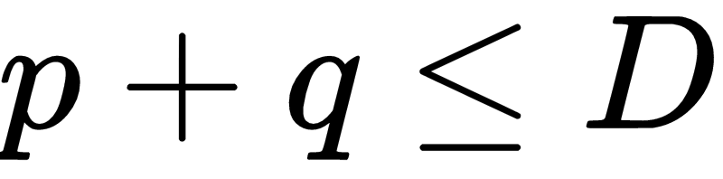
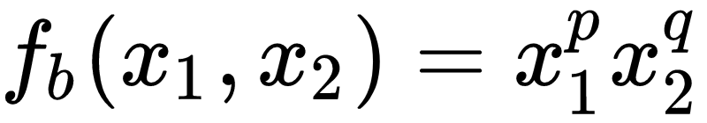
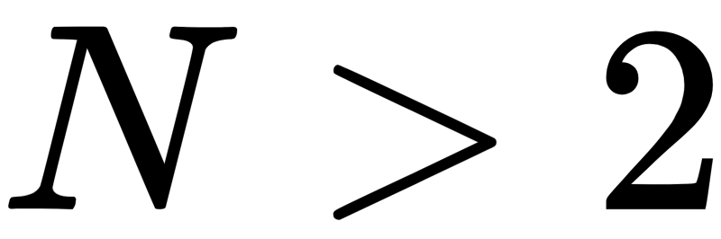
With two inputs and , a general degree D polynomial unit takes the analogous form below where p and q are non-negative integers and
Classically, a degree D polynomial is a linear combination of all such units. This definition directly generalizes to dimensional input.

Slide 28
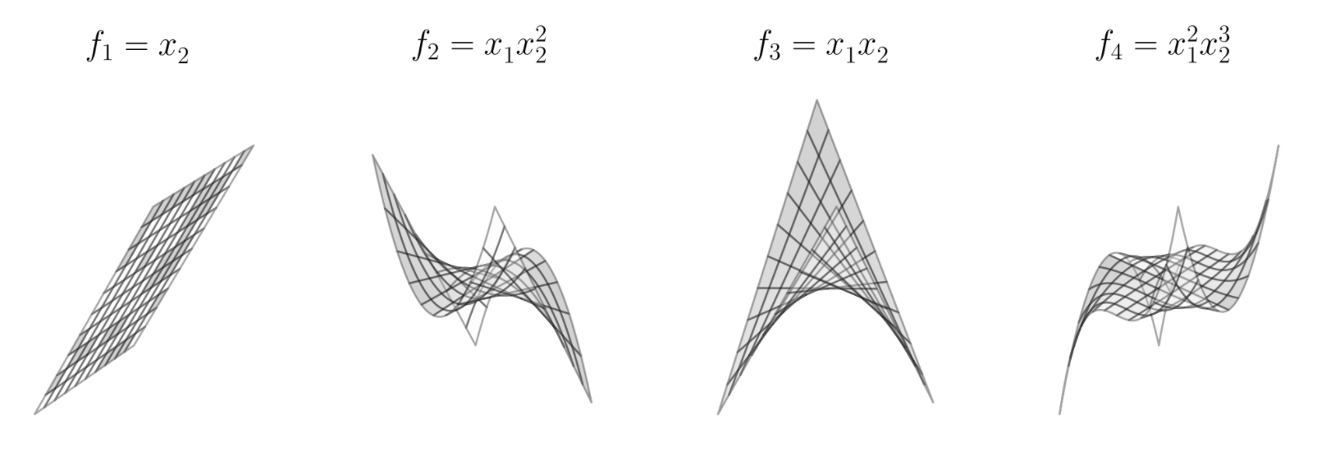

Slide 29
Example: The neural network family of universal approximators

Slide 30
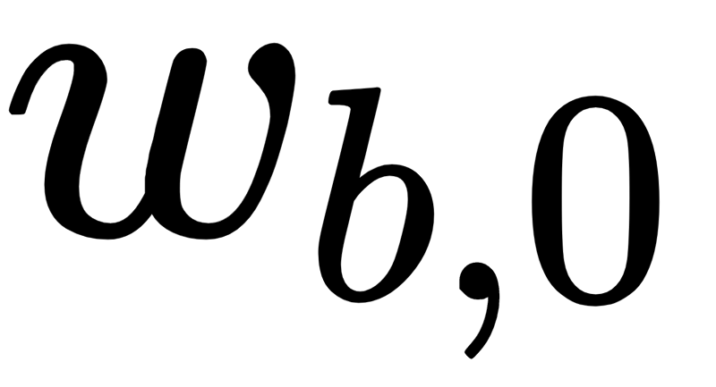
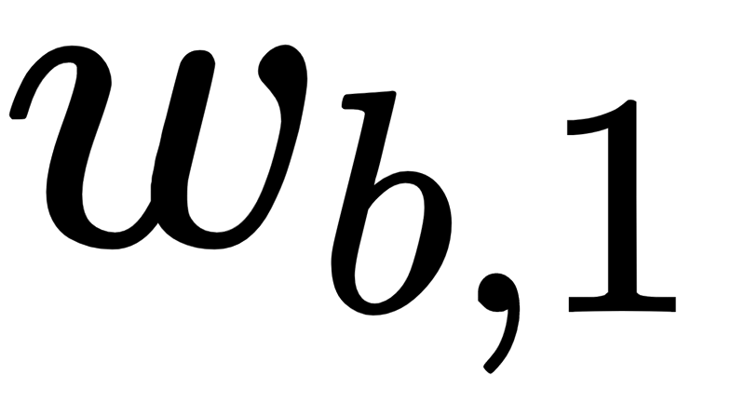

The neural networks family consists of *parameterized* functions, allowing them to take on a variety of different shapes (unlike the fixed-shape family).
The simplest kind of neural networks universal approximator is a parameterized elementary function
Notice the internal parameters and of a generic neural network function allow it to take on a variety of shapes, as illustrated below (where these parameters are set randomly).

Slide 31
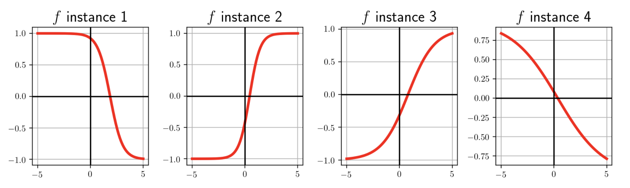

Slide 32
To construct neural network features taking in higher dimensional input we take a linear combination of the input and pass the result through the nonlinear function.
As with the lower dimensional example, each function above can take on a variety of different shapes, as illustrated below (again with randomly-set parameters).

Slide 33
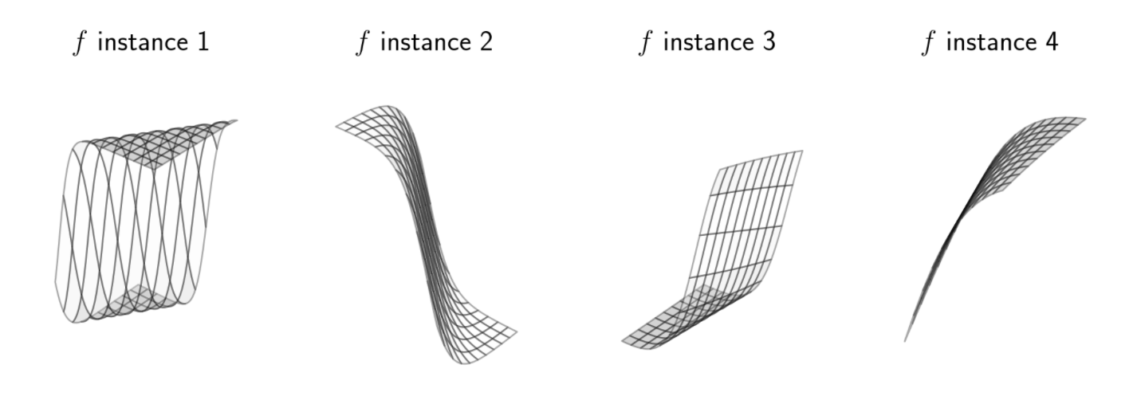

Slide 34
Example: The trees family of universal approximators

Slide 35


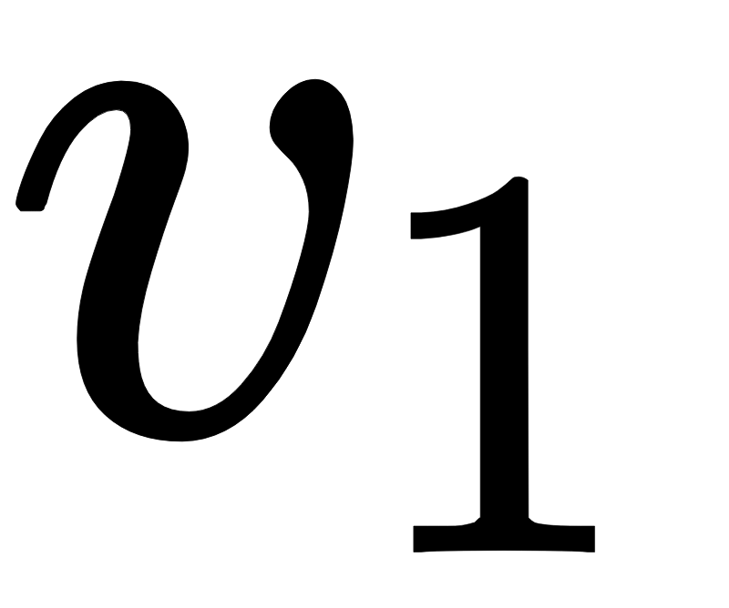
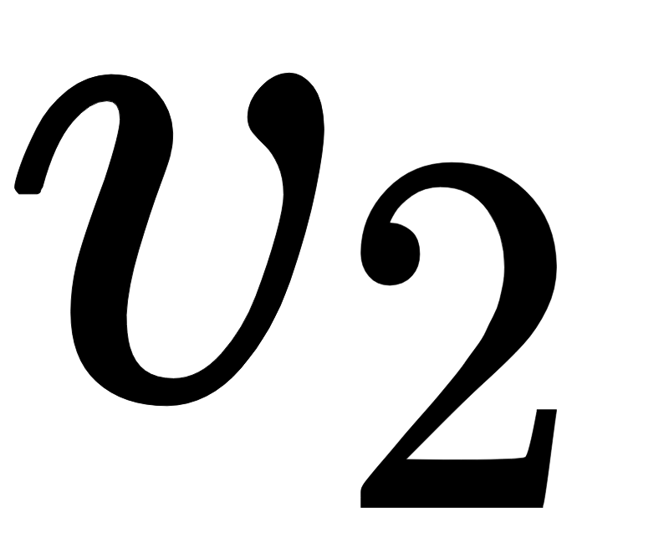
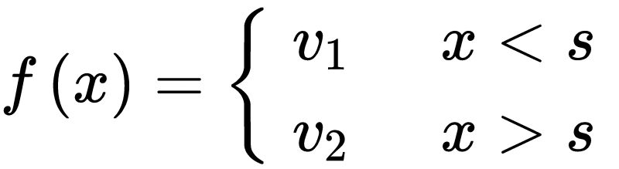
The simplest sort of tree unit consists of discrete step functions or, as they are more commonly referred to, *stumps* whose break lies along a single dimension of the input space.
A stump with one dimensional input can be written as follows where is called a *split point* at which the stump changes values, and and are values taken by the two sides of the stump respectively, which we refer to as *leaves* of the stump.
A tree-based universal approximator is a set of such stumps (see figure below).

Slide 36
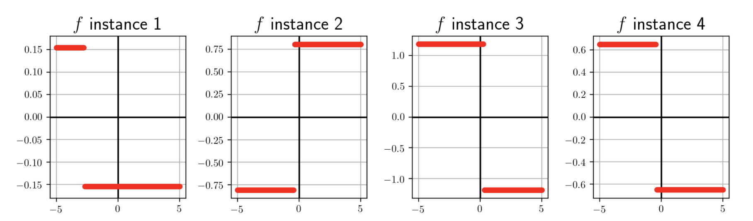

Slide 37
Higher dimensional stumps follow this one dimensional pattern.
Each side of the split is then assigned a single level value.
Figure below shows four instances of a single stump defined in two dimensions.

Slide 38
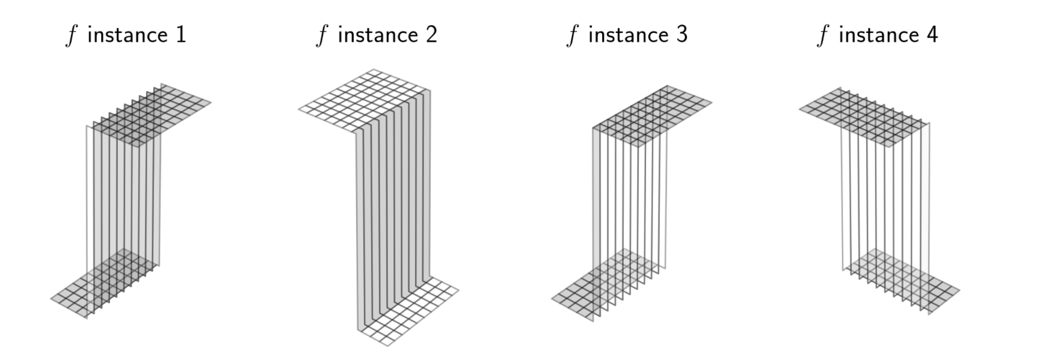

Slide 39
The capacity and optimization dials

Slide 40
With any of the major universal approximators (i.e., fixed-shape, neural networks, or trees) we can attain universal approximation to any given precision, provided that the generic nonlinear model above:
1. has sufficiently large *capacity* (e.g., by making B large enough)
2. and that its parameters are tuned sufficiently well through *optimization* of an associated cost function

Slide 41
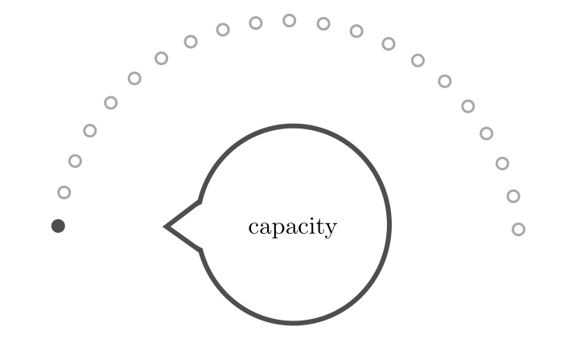
The *capacity dial* visually summarizes the amount of capacity we allow into a given model.
When set all the way to the left we admit as little capacity as possible, i.e., we employ a *linear* model.
As we move the capacity dial from left to right (clockwise) we adjust the model, adding more and more capacity.

Slide 42
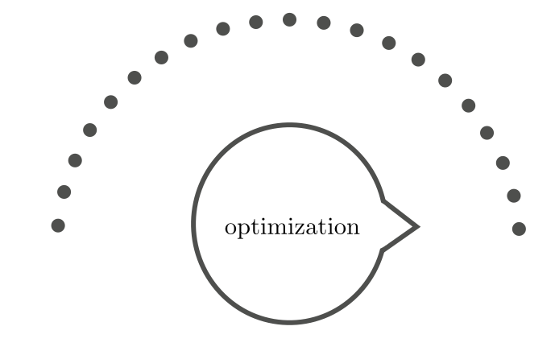
The *optimization dial* visually summarizes how well we minimize the cost function of a given model whose capacity is already set.
The setting all the way to the left denotes the initial point of whatever local optimization technique we use.
As we turn the optimization dial from left to right we move further and further along the particular optimization run, with the final step being represented visually as the dial set all the way to the right.

Slide 43
Example: Linear regression and the two dials

Slide 44
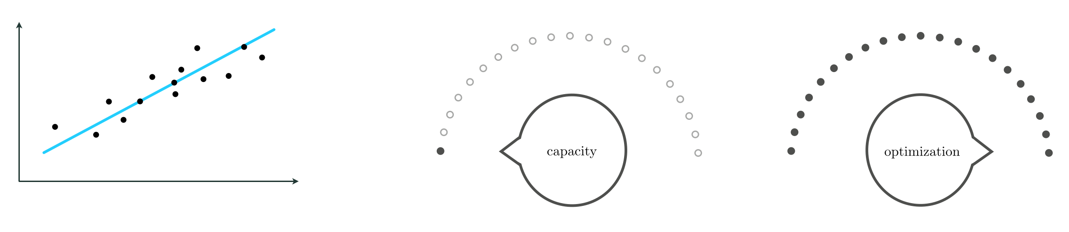
With linear regression we set the capacity dial all the way to the *left* and the optimization dial all the way to the *right* in order to find the best possible set of parameters for a low capacity linear model (drawn in blue) that fits the given regression data.

Slide 45
Example: Universal function approximation and the two dials

Slide 46
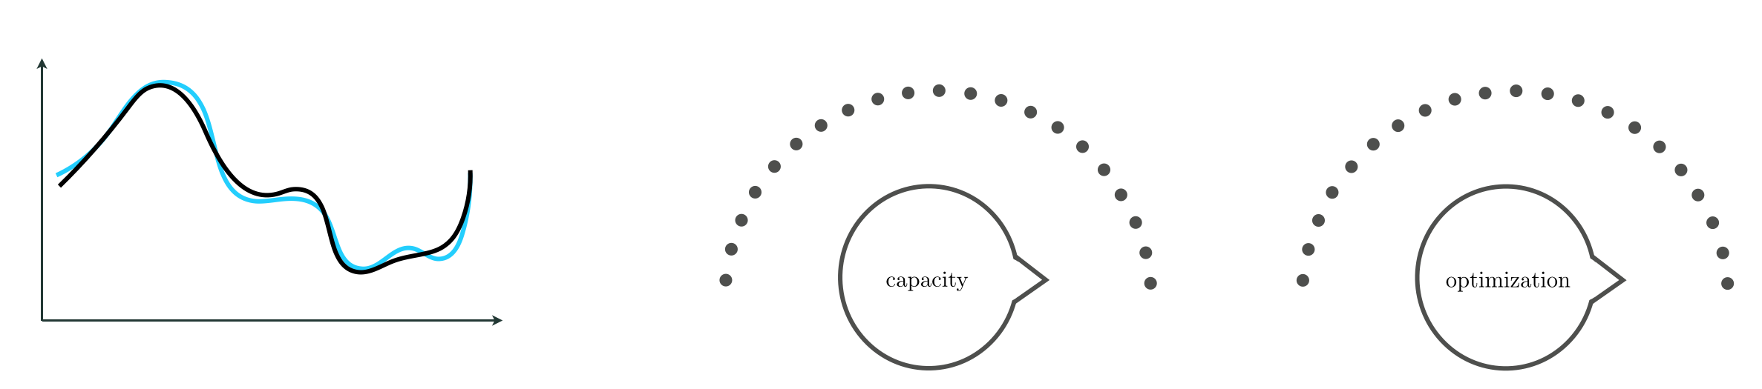
With universal approximation of a continuous function (drawn in black) we set both dials to the *right*, admitting infinite capacity into the model and tuning its parameters by optimizing to completion.

Slide 47
Example: Universal approximation of near-perfect regression data

Slide 48
In the animation below we illustrate universal approximation of a near-perfect regression dataset consisting of (P = 10,000) evenly sampled points from an underlying sinusoidal function, using
polynomial (left)
neural network (middle)
tree units (right)

Slide 49
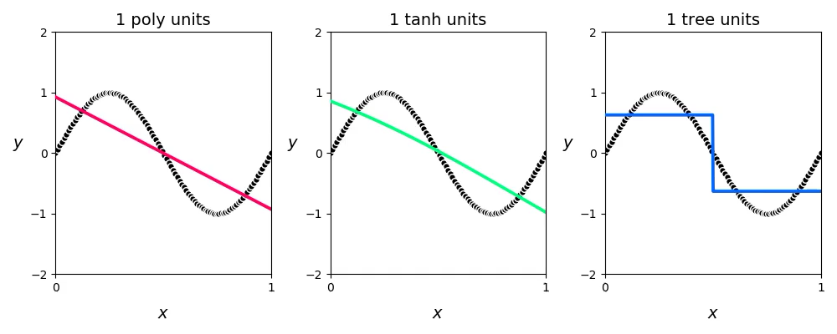

Slide 50
Note that it takes far fewer units of both the polynomial and neural networks approximators to represent the data well as compared to the discrete stumps.
This is because members of the former more closely resemble the smooth sinusoidal function that generated the data in the first place.
This sort of phenomenon is true in general: while any type of universal approximator can be used to approximate a perfect (or near-perfect) dataset as closely as desired, some universal approximators require fewer units to do so than the others depending on the shape of the underlying function that generated the dataset.

